Slide 1
XLA For optimization
Use JAX to create customized kernels to run functions on the GPU

Slide 2
What is XLA?
XLA → Accelerated Linear Algebra
Used mainly for optimizing machine learning models.
Converts a set of operations into optimized kernels depending on the device used.
Same Code → Optimized Code for CPU, GPU, TPU (Tensor Processing Unit)
Just in Time (JIT) compilation
Can be used to compile mathematical operations into optimized kernels.
Similar to automatically constructing the kernels used in the code through writing CUDA functions.

Slide 3
JAX
Developed by Google. Combines XLA and AUTOGRAD.
XLA → Accelerated Linear Algebra (jax.jit)
AUTOGRAD → Automatic differentiation of functions. (jax.grad)
Combines the NUMPY API (Matrix and Vector Multiplications) with XLA for calculation of regular python functions as XLA compiled kernels.

Slide 4
Other Functions
jax.vmap => Allows for batched processing of data.
jax.pmap => Run JITTED functions on multiple GPUs/TPUs
jax.pjit => Run a JITTED function on multiple GPUs at once. Unlike pmap, it allows for the same function to run multiple times.

Slide 5
JAX Numpy API
Provides numerous numerical functions with parallel to the NUMPY api.
Import the package with:
import jax.numpy as jnp
Follow common convention and import numpy package as:
import numpy as np

Slide 6
Functional programming
Functional programming is a programming paradigm which builds functions to manipulate data. Similar to mathematical functions which do not change the variables passed into the function but rather return the modified variables/outputs.
Why functional?
XLA compiles functions to primitive kernels.
Manipulating variables outside the function/impure functions cause problems for the compiler.

Slide 7
Demonstrated Examples

Slide 8
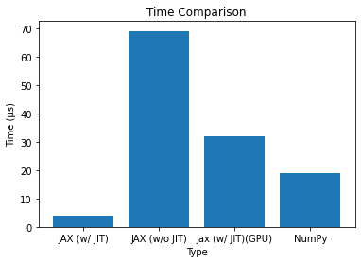
Results – Basic function

Slide 9
Note on GPU Speed
Similar to creating simple kernels on GPU in MATLAB, it becomes inefficient to utilize the GPU for simple calculations such as the example shown previously.
AKA, calling the XLA compiled function itself and then collecting the results from the computation.
As such, according to JAX docs, it is better to let the XLA compiler have a complex function to optimize rather than a set of simple functions.

